Slide 1

Final Project: Camera Calibration & Augmented Reality
● ● ● ● ●
Zeyu Wang
CIVILEN 6451
The Ohio State University
April 30, 2018
Notes:
Today, I will present a new methodology for estimation of error in adaptive Kriging reliability analysis and will present the application of this method for a few examples.

Slide 2
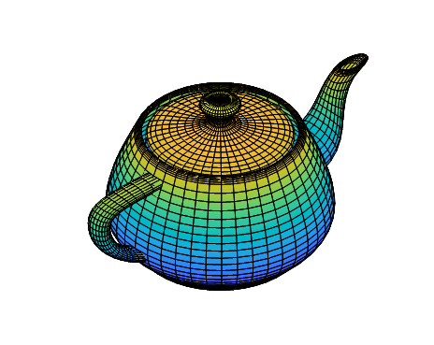
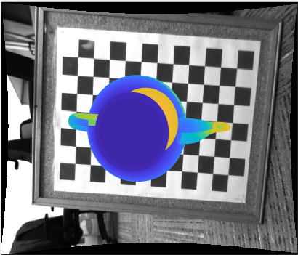
Agenda
Camera Calibration
Augmented Reality
Simple Cubic
Complex 3D teapot
Notes:
Engineered structures and systems as well as those found in nature are vulnerable against various forms of stressors that threat their functionality and integrity. Reliability analysis enables analyzing the performance of structures and systems in terms of the probability of them failing to meet a prescribed objective considering aleatoric and epistemic uncertainties in structures or systems and their stressors.

Slide 3
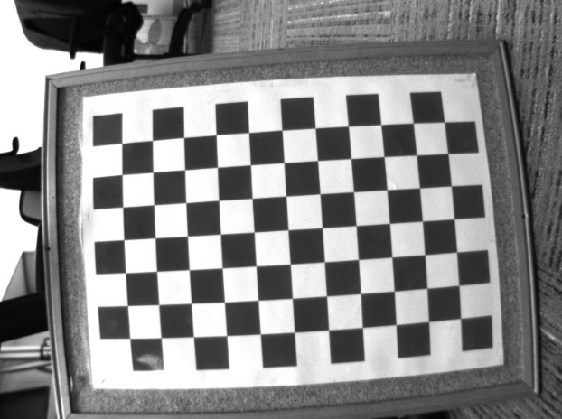
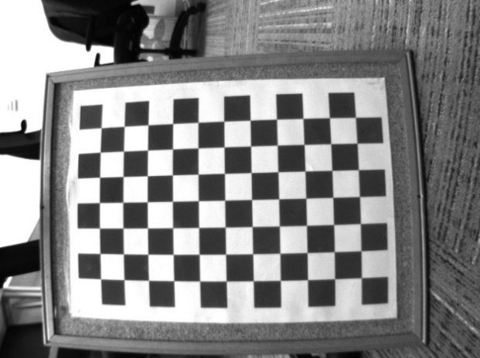
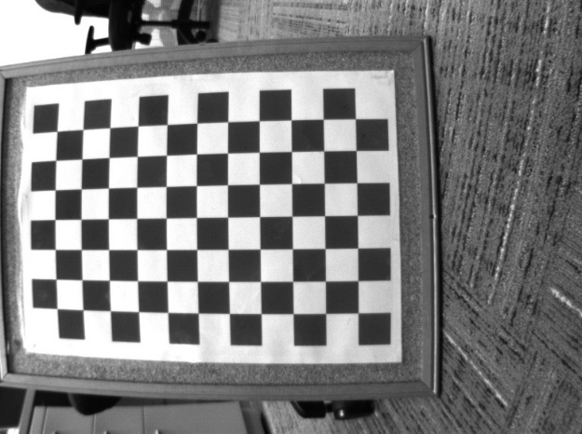
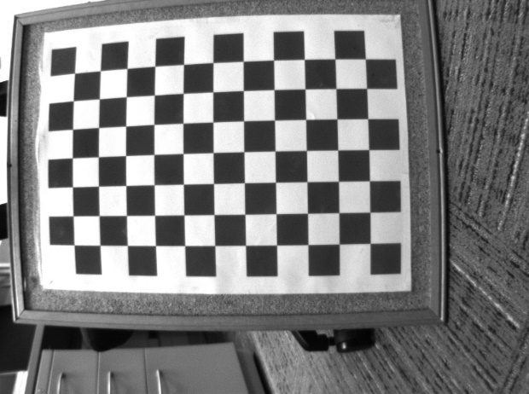
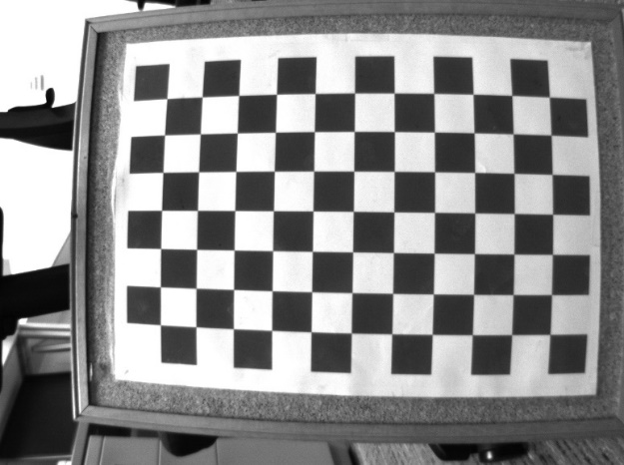
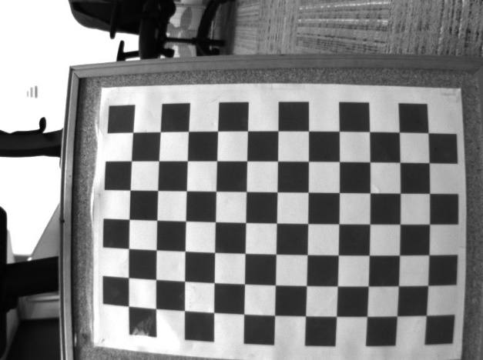
Camera Calibration
Preparing the datasets
Notes:
Generally, the analysis of reliability is conducted based on a limit state function $g\left(X\right)$, the response of which determines the condition of the system: $g\left(X\right)≤0$ indicates failure and $g\left(X\right)>0$ means safe state; the boundary region where $g\left(X\right)=0$ is called the limit state.

Slide 4
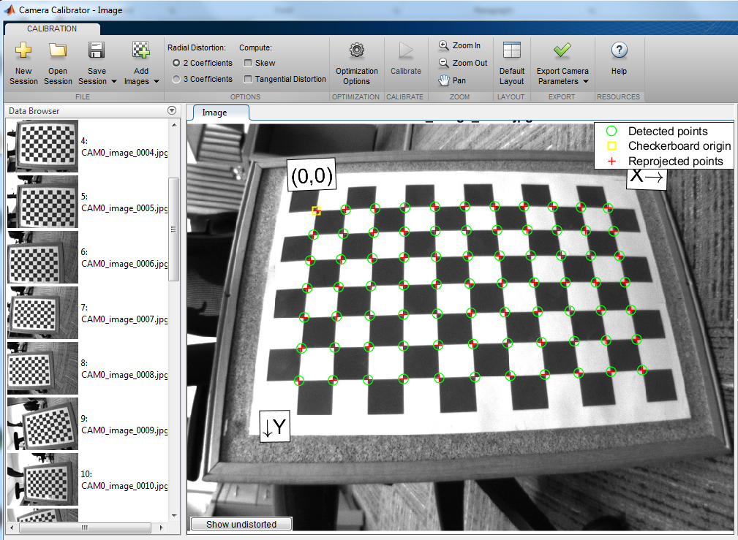
Camera Calibration:
Toolbox in MATLAB
Applying the Toolbox of camera calibration in MATLAB
Notes:
Despite the high accuracy that can be achieved using MCS method, the required significantly large number of calls to the limit state function presents a major challenge for many applications where evaluation of structure or system performance is very costly.
FORM and SORM by linearizing the performance function in the vicinity of the most probable failure point (MPP) present approximate solutions for reliability analysis problems . However, these methods fail to provide accurate estimates of $P_{f}$ in problems with highly nonlinear limit state functions.
Importance Sampling and other similar techniques improve the efficiency of reliability estimation compared to crude MCS method; however due to lack of strategic selection of design points, referred to points where limit state function is evaluated, they are not among the most efficient techniques.

Slide 5
Camera Calibration:
Extrinsic Parameters Visualization
Notes:
The Kriging is the most popular as it provides estimations of expected responses and their variance over the space of random variables in the limit state function by assuming that the true responses of the model and the predicted ones follow a joint Gaussian distribution.

Slide 6
Camera Calibration:
Camera Orientation & Position
Intrinsics
Focal length (pixels): [ 736.2635 +/- 0.2911 737.2685 +/- 0.2885 ]
Principal point (pixels): [ 404.4557 +/- 0.2295 295.1041 +/- 0.1549 ]
Radial distortion: [ -0.3243 +/- 0.0006 0.1573 +/- 0.0020 ]
Extrinsics
Rotation vectors:
[ -0.1003 +/- 0.0005 0.0769 +/- 0.0004 -0.0233 +/- 0.0001 ]
Translation vectors (millimeters):
[ -149.2130 +/- 0.137 -54.3810 +/- 0.0944 439.7155 +/- 0.1835 ]
Notes:
The Kriging is the most popular as it provides estimations of expected responses and their variance over the space of random variables in the limit state function by assuming that the true responses of the model and the predicted ones follow a joint Gaussian distribution.

Slide 7
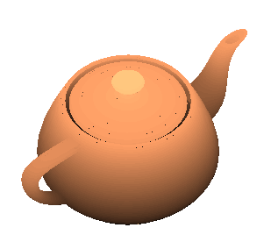
Augmented Reality
Read the Image
Eliminate the distortion of picture
Find the fiducial marker in the Image
Compute the checkerboard in real world
Compute the extrinsics vector (Rotation and translation)
Compute the camera matrix form the extrinsics and intrinsics
Show the virtual object in the picture
Notes:
where $f\left(x\right)$ is the basis function and $β$ is the regression coefficient of $f\left(x\right)$. $β^{T}f\left(x\right)$ that represents the mean value of $K\left(x\right)$ is often assumed to have ordinary ($β_{0}$), linear ($β_{0}$+$\sum_{i=1}^{N}{β_{i}x_{i}}$) or quadratic ($β_{0}$+$\sum_{i=1}^{N}{β_{i}x_{i}}$+$β_{0}$+$\sum_{i=1}^{N}{\sum_{j=1}^{N}{β_{ij}x_{i}x_{j}}}$) forms, where N is the dimension of the random input vector x.
$Z\left(x,w\right)$ is a stationary normal Gaussian process with zero mean.

Slide 8
Augmented Reality:
Simple Geometric Cubic
Notes:
where $f\left(x\right)$ is the basis function and $β$ is the regression coefficient of $f\left(x\right)$. $β^{T}f\left(x\right)$ that represents the mean value of $K\left(x\right)$ is often assumed to have ordinary ($β_{0}$), linear ($β_{0}$+$\sum_{i=1}^{N}{β_{i}x_{i}}$) or quadratic ($β_{0}$+$\sum_{i=1}^{N}{β_{i}x_{i}}$+$β_{0}$+$\sum_{i=1}^{N}{\sum_{j=1}^{N}{β_{ij}x_{i}x_{j}}}$) forms, where N is the dimension of the random input vector x.
$Z\left(x,w\right)$ is a stationary normal Gaussian process with zero mean.

Slide 9
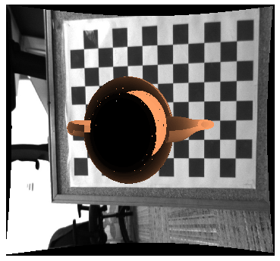
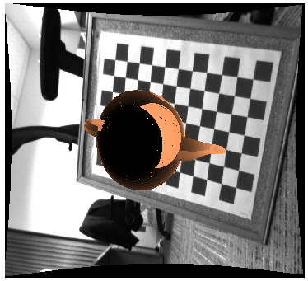
Augmented Reality:
Complex 3D teapot
The position of the teapot in the picture is not well captured accurately
Notes:
where $f\left(x\right)$ is the basis function and $β$ is the regression coefficient of $f\left(x\right)$. $β^{T}f\left(x\right)$ that represents the mean value of $K\left(x\right)$ is often assumed to have ordinary ($β_{0}$), linear ($β_{0}$+$\sum_{i=1}^{N}{β_{i}x_{i}}$) or quadratic ($β_{0}$+$\sum_{i=1}^{N}{β_{i}x_{i}}$+$β_{0}$+$\sum_{i=1}^{N}{\sum_{j=1}^{N}{β_{ij}x_{i}x_{j}}}$) forms, where N is the dimension of the random input vector x.
$Z\left(x,w\right)$ is a stationary normal Gaussian process with zero mean.

Slide 10
Final Project
Thank You!

